Slide 1
Mass Communication
Introduction

Slide 2
Overview
This will focus on the language of Mass Communication, specifically;
Important vocabulary
How language is used in mass communication
Individual aspects of certain interesting topics in mass communication

Slide 3
Key terms - Communication
Communication is the sending of a message from a source to a receiver. Here is a simple overview (1st model):
‘
‘Producing some effect’ is essential. Without it, it is not considered true communication. There must be a sharing of meaning for communication to take place.

Slide 4
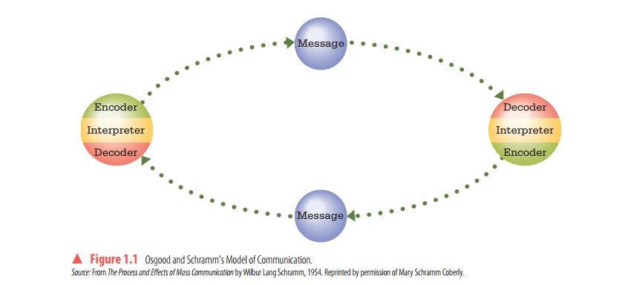
Key terms - Communication
(2nd model) Communication is actually a constant 2 way process (reciprocal):
(See page 5 example of student -> professor interaction)

Slide 5
Key terms - Communication
The second model (Osgood-Schramm) suggests that there is no individual sender/receiver, but that both subjects act as a sender and receiver at the exact same moment.
Which do you think is a better model?

Slide 6
Key terms – Mass Communication
Mass Communication is creating shared meaning between mass media and an audience.
(Mass Media is a form of public communication that reaches a large audience e.g. newspapers, TV, Video Games etc.)

Slide 7
Key terms – Mass Communication
The problem with mass communication is that the feedback is indirect or subject to problems.
e.g. TV ratings show only how many people tuned in, not if they understood the message or liked the show.

Slide 8
Differences in Communication v Mass Communication (MC)
1. Personal communication is far quicker and has more direct feedback than MC.
2. You can be more experimental in personal communication or use different approaches at once.
3. You can send more narrow and specific/personalised messages than in MC.

Slide 9
Differences in Communication v Mass Communication
4. You can however reach far more people with mass communication, meaning it is not necessarily a weaker form of communication.
Which do you think is a more powerful form of communication overall in society today (personal communication or mass communication)?

