Slide 1
Form of Mass Media 5
The Internet

Slide 2
Origins
The concept of connected computers existed as far back as the 1970s, and was known as ARPANET.
The Internet (or “internet”) as we know it is often credited to Tim Berners Lee and his invention of HTTP, otherwise known as the World Wide Web protocol (or ‘WWW’).
It was 1995 when the internet really began to grow commercially. By the late 1990s internet traffic grew by 100% each year!
Since then the internet has grown to include many services including communication (email) and data sharing (FTP, torrents, streaming etc.)

Slide 3
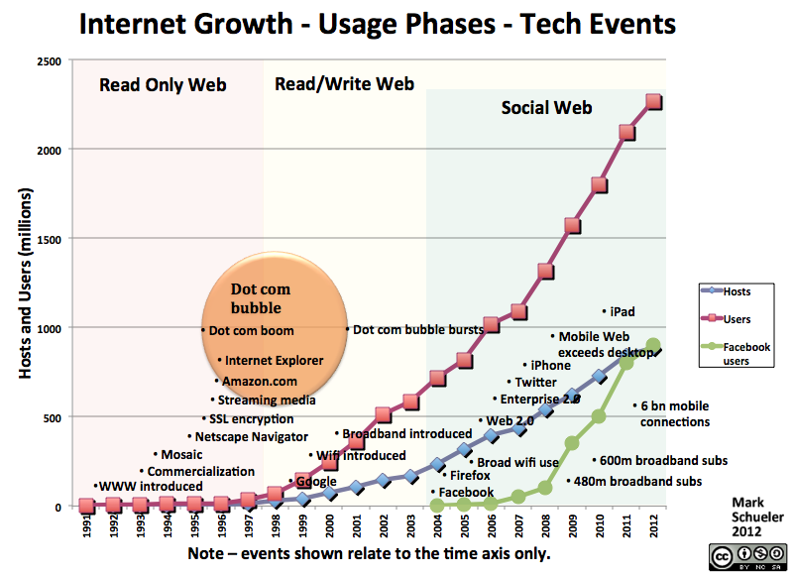
Rise
The internet has become a big part of life in most around the world since its invention.

Slide 4
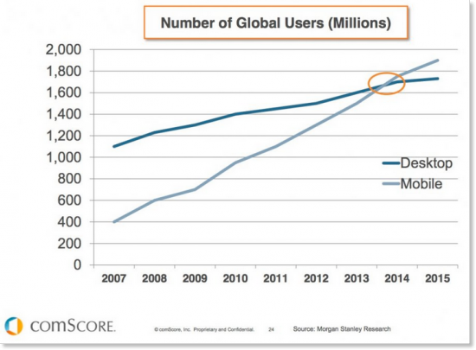
Recent Change
The most interesting thing about the internet and its growth is the speed at which the industry changes. Recently we have seen the rise of smartphones and social networking its effects.

Slide 5
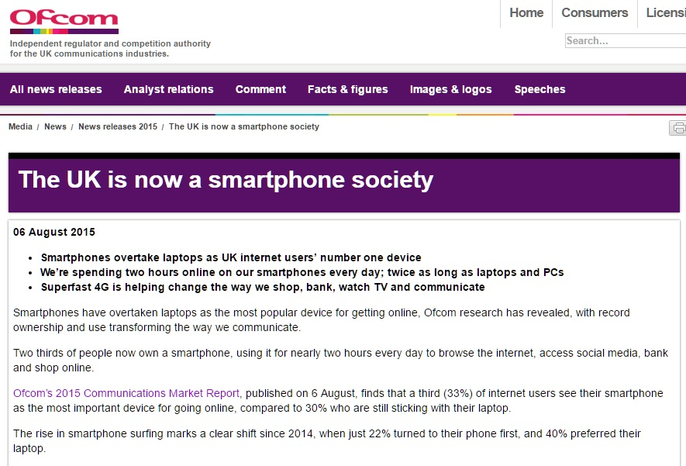
Recent Change
A recent UK Ofcom survey highlighted these changes in the UK:

