Slide 1
Form of Mass Media 4
Video Games

Slide 2
Origins
The evolution of video games probably started around the 1950s/1960s with computerized systems capable of playing chess, and pinball machines becoming popular in arcades.
Pong was the first really popular coin operated arcade machine, and it was released in 1972. There were other games before it though.
The rise of computer games took place by the 1980s with the release of home systems and an ever expanding arcade line up. 1978-1982 was known as the ‘Golden Age of Arcade Games’- Source Wikipedia
The Atari 2600 was one of the first really popular home consoles (1977) and sold 30 million+ units, priced $199 (equivalent to $700+ today).

Slide 3
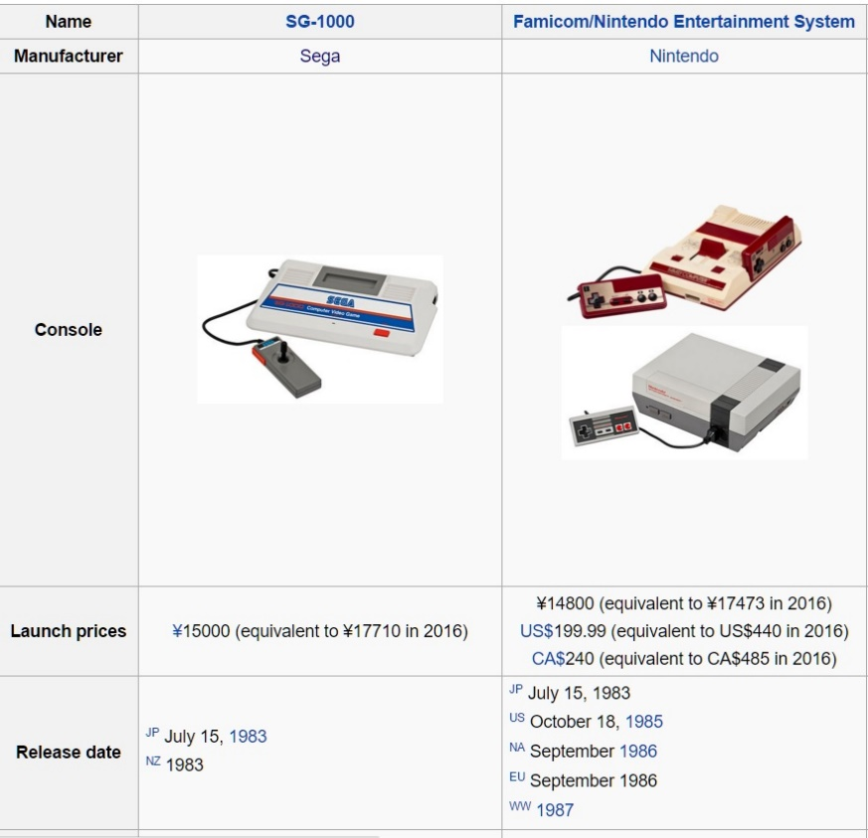
Rise in Popularity
The third generation of home consoles really led to a significant rise in the industry. Nintendo and Sega released their first consoles on July 15, 1983 (the same day!)
Nintendo was the most successful company due to their Mario, Zelda and Metroid games.

Slide 4
The Video Game Industry Today
The video game industry was worth twice as much money in 2013 than the film industry. Worldwide box-office revenue for the film industry in 2013 was $35.9 billion and for the video game industry was $70.4 billion.
It continues to grow in many new forms, and mobile gaming is estimated to be worth $45bn alone by 2018.

Slide 5
Interesting Facts About Video Games
Nintendo used to sell trading cards and even ran love hotels before they got into video games! They have been around since the 1880s.
Mario first appeared in Donkey Kong (1981) and was simply known as ‘Jumpman.’
The Sony made CD add-on for the SNES (“The SNES-CD”) was eventually dropped but went on to become The Playstation!
48% of all game players are women, and younger girls (under 18) represent a bigger portion of the game playing population than boys (under 18).

