Slide 1
Form of Mass Media 3
Radio, Recording and Popular Music

Slide 2
Origins
Radio has been around as an invention since the first radio waves were sent in the mid to late 1800s.
Heinrich Rudolf Hertz transmitted radio waves (called Hertzian waves) around 1886.
Guglielmo Marconi is credited as being the first true inventor of the radio (1894), although many people worked on it before and after.
The first radio news program was broadcast on August 31, 1920

Slide 3
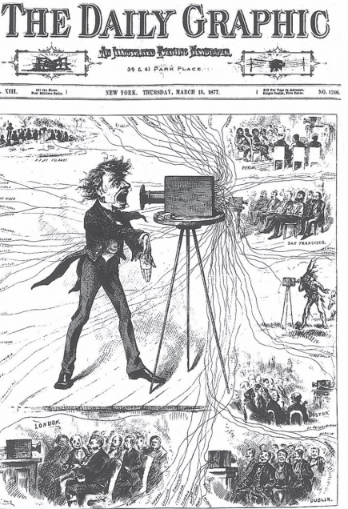
Prediction
Even though commercial broadcast radio (sound transmitted to many people) was not introduced until 1920, the New York Daily Graphic predicted it as early as 1877

Slide 4
Growth
Radio grew to be a massive industry ($454m dollars in advertising revenues in 1950 alone)
Even after the invention of the TV (when advertising revenues dropped to $35m in 1960), many people still preferred radio as a source of information, particularly news.
There are many different types of style of radio today (p162) and it is said that in 2011, 93.1% of Americans listened to radio in a normal week

Slide 5
Change
Radio is still popular today, but the numbers of teenagers listening is in decline (due to technology)
Podcasting has become a popular form of modern day ‘radio’. (The Serial Podcast was downloaded an estimated 70m times by the end of 2015).
Is podcasting and streaming the future of radio?

