Slide 1
MCS 1350 Speech Communication
How To Win Friends & Influence People

Slide 2
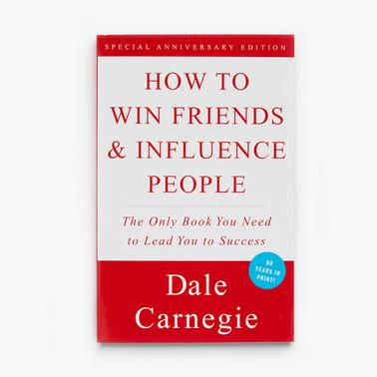
How To Win Friends & Influence People
The Book How To Win Friends & Influence People Was First Released In 1936 And May Be Considered An Early Self Help Book .

Slide 3
Questions Principle 6 ( Part 2 Principle 3 )
What Did Mr Farley Do ? P102/103
What Was The Reason For Andrew Carnegie’s Success ? P104
What Feedback Did Karen Kirsech Get ? P106
What Did Napoleon The Third Claim? P108
What Is Principle 3 ? P109

Slide 4
The Book
The Book Focuses On Six Main Aspects :
Fundamental Techniques In Handling People
Six Ways To Make People Like You
Twelve Ways To Win People To Your Way Of Thinking
Nine Ways To Change People Without Giving Offense Or Arousing Resentment
Letters That Produced Miraculous Results
Seven Rules For Making Your Home Life Happier

