Slide 1
General Sentence of the day
1

Slide 2
How many times bigger is ________ than________?
‘Times’ can refer to many different forms of comparison….volume, price, cost, profitability, surface area, income, height, weight etc.

Slide 3
Think about the Sun compared to the Earth
How many times bigger is the Sun than the Earth?
Can you guess an answer?

Slide 4
Think about the Sun compared to the Earth
How many times bigger is the Sun than the Earth?
The correct answer is that the Sun is 1.3 million times bigger than the Earth!

Slide 5
Think about the biggest star VY Canis Majoris compared to the Sun
How many times bigger is VY Canis Majoris than the Sun?
Can you guess an answer?

Slide 6
Think about the biggest star VY Canis Majoris compared to the Sun
How many times bigger is VY Canis Majoris than the Sun?
The correct answer is that VY Canis Majoris is 1 billion times bigger than the Sun!

Slide 7
So…..
How many times bigger is VY Canis Majoris than the Earth ?
VY Canis Majoris is 7x10¹⁵ times bigger than the Earth
7,000,000,000,000,000 times bigger!

Slide 8
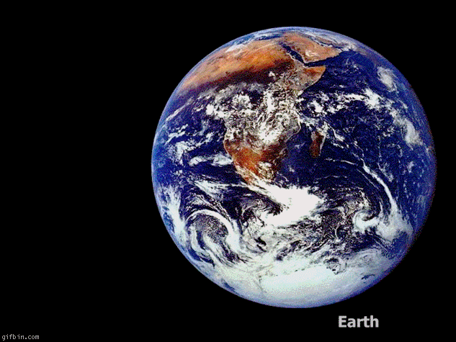
Let us see this in image form

Slide 9
Further reference
http://www.rense.com/general72/size.htm
http://www.youtube.com/watch?v=4DklAFnabEg
http://www.youtube.com/watch?v=c8CgDGhYKe8

